Slide 1



Introduction to Text Classification with NLP
Explore the world of Natural Language Processing and text classification. Learn how machines understand human language and categorize text into predefined categories.
by Aravind K
Notes:
1

Slide 2
Understanding NLP and Text Classification
Natural Language Processing (NLP)
Text Classification
AI field enabling machines to understand and process human language.
Categorizing text into predefined categories, such as "spam" or "ham".
Notes:
2

Slide 3
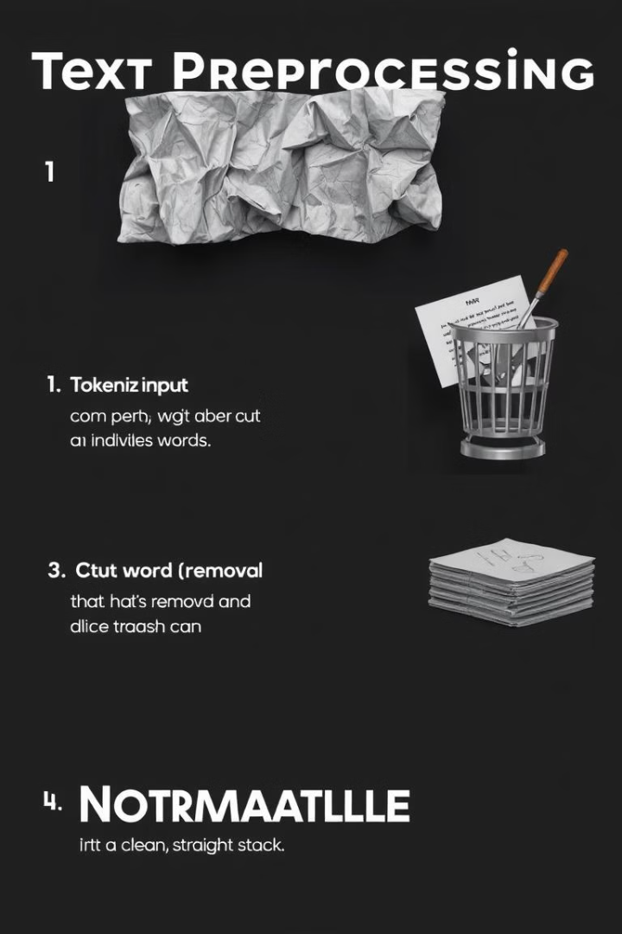
Text Preprocessing
Tokenization
1
Breaking text into individual words or tokens.
Stopword Removal
2
Eliminating common words that don't contribute to meaning.
Normalization
3
Converting text to lowercase for consistency.
Notes:
3

Slide 4

Feature Extraction
TF-IDF
Importance
Term Frequency-Inverse Document Frequency converts text data into numerical features.
Helps represent text as numbers for machine learning models.
Notes:
4

Slide 5




Model Training
Data Preparation
Preprocess and vectorize text data.
Logistic Regression
Train model for binary classification (spam/ham).
Model Output
Predict message categories.
Notes:
5

Slide 6
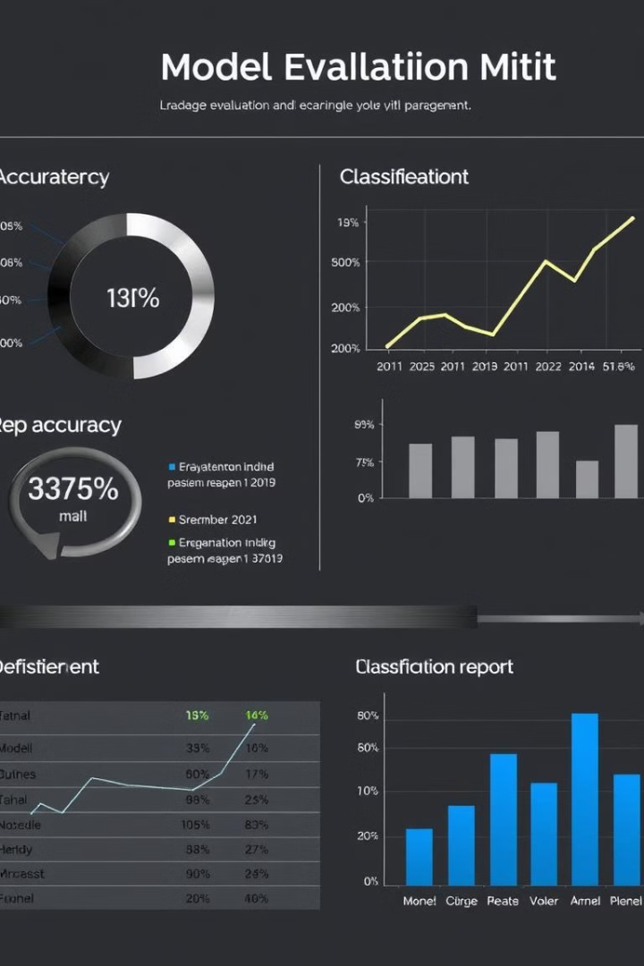
Model Evaluation
1
Accuracy
2
Classification Report
Measure of correct predictions (0.0 due to small dataset).
Provides precision, recall, and F1-score for spam and ham categories.
Notes:
6

Slide 7
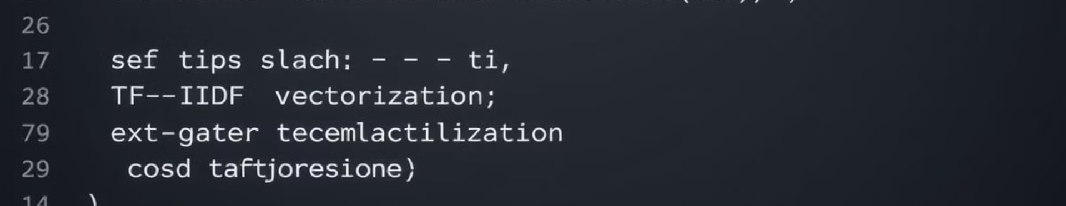
Code Walkthrough
preprocess_text()
Clean and tokenize text, remove stopwords
TfidfVectorizer
Convert cleaned text to numerical features
Logistic Regression
Train model on vectorized data
Notes:
7

Slide 8




Conclusion and Future Improvements
Successful Implementation
Text classification model using NLP and Logistic Regression.
Larger Datasets
Use more data for better model performance.
Advanced Models
Consider Random Forests or SVM for improved results.
Notes:
8

